Slide 1
From Assessment to Placement: Uncertainty and Effort Choice
Rajlakshmi Mallik
Centre for Development Research,
Sustainability & Technical Advancement
rajlakshmi.mallik@gmail.com
Diganta Mukherjee
Indian Statistical Institute, Kolkata
digantam@hotmail.com
International Conclave on Foundations of Decision and Game Theory
14th – 19th Mar 2016

Slide 2
The link….
between education and employment is crucial for economic development
Education generates human capital, a necessary input in the development process, by enhancing an individual's embodied skills above their raw labour ability (Belfield and Levin, 2003, Cohn and Addison, 1998, Goldin and Katz, 1998).
Education generates valuable job market information about the skill levels of the potential recruits

Slide 3
Higher Education: a three-activity process
Training (effort by teacher and student) → skill formation (unobservable but verifiable)
Assessment (effort by teacher) → certificate of student skill (observable)
Placement after external assessment by recruiters → jobs (observable)

Slide 4
Nature of teacher’s efforts involved in teaching and assessment are very different therefore we consider these separately
Examinations may be part of the training process itself although here examinations play the role of only assessment leading to certificates
Student’s effort in participating in examination process is not considered:
Assessment process or examination is not modelled separately. Its outcome i.e. student grade depends only on true student ex-post skill (which again is dependent on teacher effort and student effort in learning) and teacher effort in assessment of that skill.
Student effort in exam cannot influence learning / ex-post skill or the grades; (alternatively we could assume student’s additional effort cost for participating in exams is zero as this is similar to learning effort)

Slide 5
Various newspapers and industry magazines publish lists of rankings of business schools in India. Whilst criteria for each publication differs, business schools included in rankings are those with full-time Master of Business Administration (MBA) or Post-Graduate Diploma in Management (PGDM) programs.
Factors normally taken into account include placement, quality of faculty, quality of students, quality of infrastructure, industry brand image and fees.

Slide 6
The Development Question
Higher Education Process: Training, Assessment, Placement
Two observations:
Stress on student placement as an indicator of quality of academic process and teaching quality
The huge resource expenditure and large variety of measures related to the recruitment process and the declining credibility or importance of certification by institutions of higher education, in the recruitment process.

Slide 7
The Development Question (contd)
Questions:
How to design an incentive scheme or pay structure that will improve
1 - teaching – learning effort and level of skill formation &
2 – assessment effort and ensure credible certification of student skill level?
Does rewarding teaching effort based on student placements help to achieve 1 above?
Will rewarding assessment effort based on match between certificate and placement level help to achieve 2 above?

Slide 8
Framework that incorporates observed features of the HE process:
Joint role played by teachers and students in training and skill formation process
Assessment as a separate activity performed by teachers in addition to teaching
Assessment as a more laborious activity compared to teaching; easier to grade extreme quality
Placement based on recruiter assessment in addition to institutional assessment (by teachers) who impart the skill
Teacher pay based on student placement and also on match between institutional and recruiter assessment

Slide 9
Early Literature
Education generates human capital by enhancing an individual's embodied skills above their raw labour ability (Belfield and Levin, 2003, Cohn and Addison, 1998, Goldin and Katz, 1998).
Rothschild and White (1995) and Dolan et. al. (1985) stress on the joint role played by students (willing to invest their time and effort to learn skills) and teachers (who have the skill and are able to impart the training) in the generation of human capital.
University managers influence the technical efficiency of the universities by allocating resources within the institution and acting as principals in structuring incentives for the agents (Johnes, 1999).
Performance related pay (PRP) for teachers: evidence for a positive impact of teacher salary levels on students’ outcomes at the school level (Loeb and Page, 1999, Dewey et al, 2000).
Teacher pay affects teacher performance by influencing the recruitment and retention of more able teachers (Jacobson, 1995, Dolton and Van der Klaauw, 1996, 99)
Induces better performance by continuing teachers (Hanushek et al, 1999).

Slide 10
The Model
Game with two players – a teacher and a student.
The players perform two activities resulting in two outputs.
Teaching: Skill formation or quality q (unobservable) which involves effort by both the teacher and the student; t and e
Assessment: Certificate or student grade ${\hat{q}}_{T}$, requires effort by only the teacher, in assessing student quality; $a$
All efforts are unobservable.
All efforts are costly to the agents; Teacher prefers teaching to assessment
Framework: multi-tasking with multiple agents.
Teacher chooses t and $a$ simultaneously with student choosing e.

Slide 11
The Model (contd.)
Placements: happen based on teacher’s certificates of student skill / student grades and external assessment by recruiting firm
Firm’s effort in assessment, $τ$ is given exogenously; firms play a passive role

Slide 12
Educational Production Function:
$q=Q\left(t,e\right)=te, t,e∈[0,1]$ …………….(1)
t and e: effort levels chosen by the teacher and the student in teaching and learning respectively, which are unobservable; q refers to the skill or “quality” generated by the training process.
Quality Assessment:
Evaluation of student quality happens twice – internal assessment by teacher and external by recruiting firm when student enters job market
Evaluation procedure is not perfect and grades assigned are noisy estimates

Slide 13
Internal Assessment / Grading by Teacher:
${\hat{q}}_{T}$, the teacher’s estimate of student quality or the grade assigned to the student by the teacher,
${\hat{q}}_{T}∈(0,1)$: $E\left({\hat{q}}_{T}\right)= q and V\left({\hat{q}}_{T}\right)= σ\left(1−a\right)q\left(1−q\right) σ∈\left(0,1\right), a∈[0,1]$………(2)
Expected value of grade correctly measures true quality.
Accuracy of grade increases (variance decreases) with assessment effort and the extremity of the true quality; and with improvement in state of evaluation technology (exogenously given imprecision parameter $σ$ has a smaller value)
External Assessment / Grading by Recruiting Firm:
${\hat{q}}_{F}$ has the following properties:
$E\left({\hat{q}}_{F}\right)= q and V\left({\hat{q}}_{F}\right)= σ \left(1−τ\right)q\left(1−q\right) τ∈(0,1)$……….. (3) ($τ$ is exogenous)

Slide 14
Student’s Payoff:
The pay packet offered by the recruiter, π$∈(0,1)$, is given by
$π=φ{\hat{q}}_{F}+\left(1−φ\right){\hat{q}}_{T} φ∈(0,1)$…………..(4)
Student payoff is the salary the student receives from the firm less the effort cost in learning: $c\left(e\right)=\frac{1}{2}e^{2}$
$S=π−c\left(e\right)=π−\frac{1}{2}e^{2}$……………………….(5)
Tuition fee is not considered in this model. A lump sum fee at the time of entry would not affect any of the results and would only influence student participation in the education process.

Slide 15
Teacher’s Payoff:
The teacher’s pay has two components – reward for teaching at the rate $λ$, based on placement level and reward for assessment based on match between placement and grade (or penalty for wrong assessment $γ$ based on discrepancy) :
$P= λπ− γd^{2} λ, γ>0$……………………….(6)
where $d= {\hat{q}}_{F}−{\hat{q}}_{T}$ …………………….. (6a)
The teacher’s dis-utilities from teaching and assessment efforts:
$C\left(t\right)=\frac{1}{2}{θt}^{2}$;$c\left(a\right)=\frac{1}{2}a^{2}$ $; 0<θ<1$
Here $θ$ is assumed to be less than one ($θ<1)$, to indicate the teacher’s marginal disutility from teaching is less than that for assessment.

Slide 16
Teacher’s Payoff:
The teacher’s payoff is the teacher’s salary less the dis-utilities from teaching and assessment efforts:
$T=λπ− γd^{2}−\frac{1}{2}{θt}^{2}−\frac{1}{2}a^{2} θ∈\left(0,1\right)$………………..(7)
Substituting for $π$ and $d$ using (4) and (6a) the teacher’s payoff may be written as:
$T=λ[φ{\hat{q}}_{F}+\left(1−φ\right){\hat{q}}_{T}]− γ({{\hat{q}}_{F}−{\hat{q}}_{T})}^{2}−\frac{1}{2}{θt}^{2}−\frac{1}{2}a^{2}$……………(8)

Slide 17
Working of the Model: Effort Choice
All agents maximize their expected payoffs; solve for Nash equilibria of the game.
Student
Optimal choice of effort in learning is obtained as solution to the following optimization problem:
${Max}_{e}E\left(S\right)=q−\frac{1}{2}e^{2}$ ………………………..(9)
The first order condition for the above maximization problem yields,
$$\frac{∂E\left(S\right)}{∂e}=t−e=0$$
$⇒e=t≡e^{∗}$……………………….(10)

Slide 18
Working of the Model: Effort Choice
Teacher
Optimal choice of effort in teaching and assessment is obtained as solution to the following optimization problem:
${Max}_{t,a} E\left(T\right)$ ……………..(11)
$E(T)=λq− γσq\left(1−q\right)[\left(1−a\right)+\left(1−τ\right)]−\frac{1}{2}{θt}^{2}−\frac{1}{2}a^{2}$ …………………(12)
The first order conditions:
$\frac{∂E(T)}{∂a}=0 ⇒a= γσq\left(1−q\right)≡a^{∗}$…………(13)
$\frac{∂E\left(T\right)}{∂t}=0⇒λe− γσ\left(2−τ−a\right)\left(e−2te^{2}\right)− θt=0$ ………….(14)

Slide 19
Teacher’s expected payoff:
Since and
$$E(T)=λq− γ[V\left({\hat{q}}_{F}\right)+V({\hat{q}}_{T})]−\frac{1}{2}{θt}^{2}−\frac{1}{2}a^{2}$$
$$⇒E(T)=λq− γσq\left(1−q\right)[\left(1−a\right)+\left(1−τ\right)]−\frac{1}{2}{θt}^{2}−\frac{1}{2}a^{2}$$
$$E\left({\hat{q}}_{F}\right)=E\left({\hat{q}}_{T}\right)= q$$
$E[\left({{\hat{q}}_{F}−{\hat{q}}_{T})}^{2}\right]= E[\left({{\hat{q}}_{F})}^{2}\right]−{\left[E\left({\hat{q}}_{F}\right)\right]}^{2}+E[\left({{\hat{q}}_{T})}^{2}\right]−{\left[E\left({\hat{q}}_{T}\right)\right]}^{2}−2E\left({\hat{q}}_{F}\right)E\left({\hat{q}}_{T}\right)+2q^{2}=V\left({\hat{q}}_{F}\right)+V\left({\hat{q}}_{T}\right)$

Slide 20
Substituting ${ e}^{∗}$ and $a^{∗}$for $e$ and $a$ in (14) yields the following polynomial in t:
$$t\left(λ−θ\right)−γσt(1−{2t}^{2})[\left(2−τ\right)−γσt^{2}\left(1−t^{2}\right)]=0$$
This may be expressed as product of t and a third degree polynomial in $t^{2}(=q)$, W:
$$t.W=0$$
$$W=\left(A−mB\right)+m\left(m+2B\right)q−3m^{2}q^{2}+2m^{2}q^{3}$$
where $A=λ−θ;m=γσ;B=\left(2−τ\right)$
So either t = 0 or t is obtained as solution to the equation W = 0; this will have one or three positive solutions and hence one or three real positive solutions in t

Slide 21
Lemma 1: The function W is strictly monotonically increasing in q
Lemma 2: (a) There exists equilibrium t, iff
$$θ−σ\left(2−τ\right)γ≤λ≤θ+σ(2−τ)γ$$
(b) Only one real solution will exist
Proposition: $q^{∗}≥or <\frac{1}{2} according as λ ≤or > θ$

Slide 22
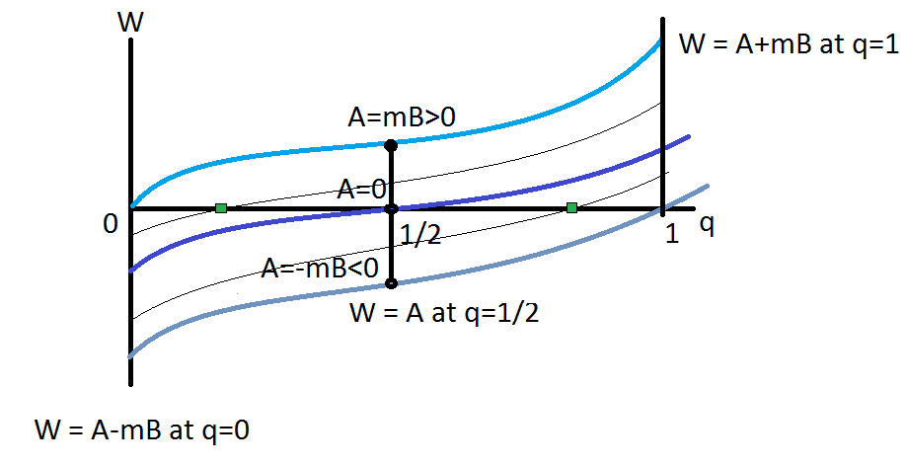
Solution Characterisation:
$$−mB≤A≤mB⇒θ−σ\left(2−τ\right)γ≤λ≤θ+σ(2−τ)γ$$

Slide 23
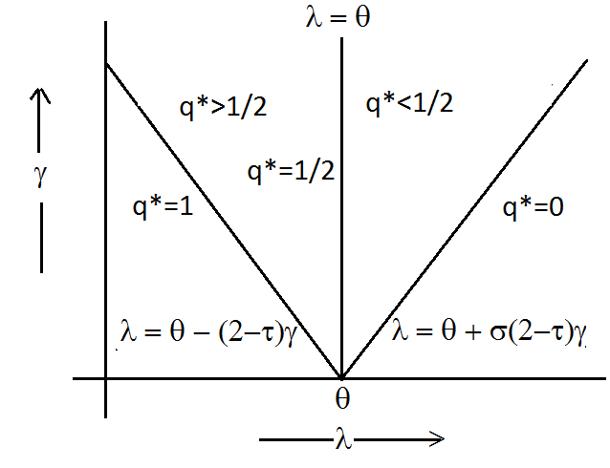
Solution Characterisation:

Slide 24
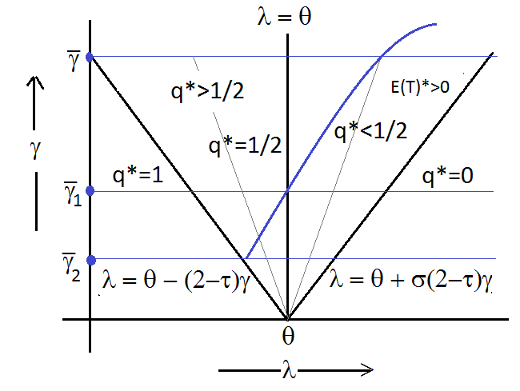
Solution Characterisation: Participation Constraint

Slide 25
Student chooses same effort as teacher
Assessment effort will be higher if:
Technology is imprecise
Penalty rate is higher
Carrot and stick policy:
Too much stress on placements as an indicator of teaching effort may be counterproductive i.e. rewarding teaching effort based on student placements will result in poor quality or skill level
Penalty for wrong assessment may induce teachers to teach well and ensure high level of quality or skill formation (as students will match teacher effort) and improve probability of correct assessment.

Slide 26
The Development Question
Higher Education Process: Training, Assessment, Placement
What we know and observe:
Activities involved
Effort
Disutility from effort
Skill formation
Certification
Performance measurement, its indicators and pay structure
What we suggest:
Alternative pay structure
What we may infer:
Effect on quality of education process – skill level and credibility of certification
Whether PRP for teachers will work or not?

